Slide 1
Foundation
SQL – Joining Tables – Part 2

Slide 2
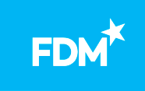
Module Objectives
After completing this module you will be able to:
Describe the purpose of and implement advanced joins

Slide 3
Joining Tables
Self Join
Cartesian Join

Slide 4
Self Joins
A table is joined to itself
For example: An employee table containing a list of employees and their corresponding managers who are also employees
Table1
Table1
Notes:
Note that the self join can use an inner join or an outer join – the main thing is that one table is joined to itself

Slide 5
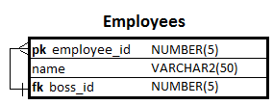
Scenario
Your trainer will give you a script to create and populate the Employees table.
Notes:
The script is called ‘employees table setup.sql’ and can be found in the “Slides” folder in the course materials on the LMS.

Slide 6
Self Joins – Scenario
Display a list of employee names and the names of their bosses.

Slide 7
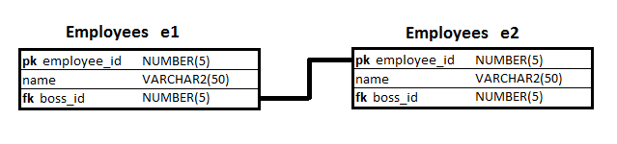
Self Joins – Solution
Use aliases to create two instances of the employees table.
Join the instances using an inner join

Slide 8
Self Joins - Solution
SELECT e1.name AS employee,
e2.name AS boss
FROM employees e1
INNER JOIN
employees e2
ON e1.boss_id = e2.employee_id;
Notes:
Note: the use of aliases with self joins is mandatory, not just a convenience. Without an alias it would not be possible to create and reference another instance of the same table.

Slide 9
Self Joins - Practice
Write queries which give the following information:
Display a list of all employee names and the names of any bosses they may have.
Display a list showing only employees without a boss.

Slide 10
Self Joins – Further Practice
Write queries which give the following information:
Display a list of all bosses' names and the names of any employee they may manage.
Display a list showing only bosses that do not manage any employees.

Slide 11
Joining Tables
Self Join
Cartesian Join

Slide 12
A brief history of joins
The words JOIN and ON did not appear in the original SQL syntax. Cartesian joins were used instead.
INNER JOIN & OUTER JOIN were introduced in 1992.
On site you may still find some people using the old fashioned syntax, so it’s important to be aware of it.
At FDM we teach you the current best practice, so you should only use the new syntax when writing queries during this course.

Slide 13
Cartesian Join
Returns a Cartesian product of rows within the tables
Combines each row in the first table with each row from the second table
Useful for producing test data to achieve maximum combinations of different rows in several tables
Old syntax of a Cartesian Join. Do NOT use it
SELECT b.broker_id, se.stock_ex_id
FROM brokers b, stock_exchanges se;
New syntax of a Cartesian Join. Use CROSS JOIN keywords
SELECT b.broker_id, se.stock_ex_id
FROM brokers b CROSS JOIN stock_exchanges se;
What does this query return?
How many rows are there?

Slide 14
Joining tables: Old syntax vs. New syntax
Old syntax. Do NOT use it, but you may still see it in some old code
SELECT b.broker_id,
t.trade_id
FROM brokers b, trades t
WHERE b.broker_id = t.broker_id;
New syntax. Best practice approach
SELECT b.broker_id,
t.trade_id
FROM brokers b
INNER JOIN
trades t
ON b.broker_id = t.broker_id;

Slide 15
Review
What is a self join?
When would you use a self join?
If you use a Cartesian join to join 3 tables which each have 100 rows, how many rows would be returned?
What is a Cartesian join?

Slide 16
Questions

Slide 17
Module Objectives
You should now be able to:
Describe the purpose of and implement advanced joins

